Slide 1
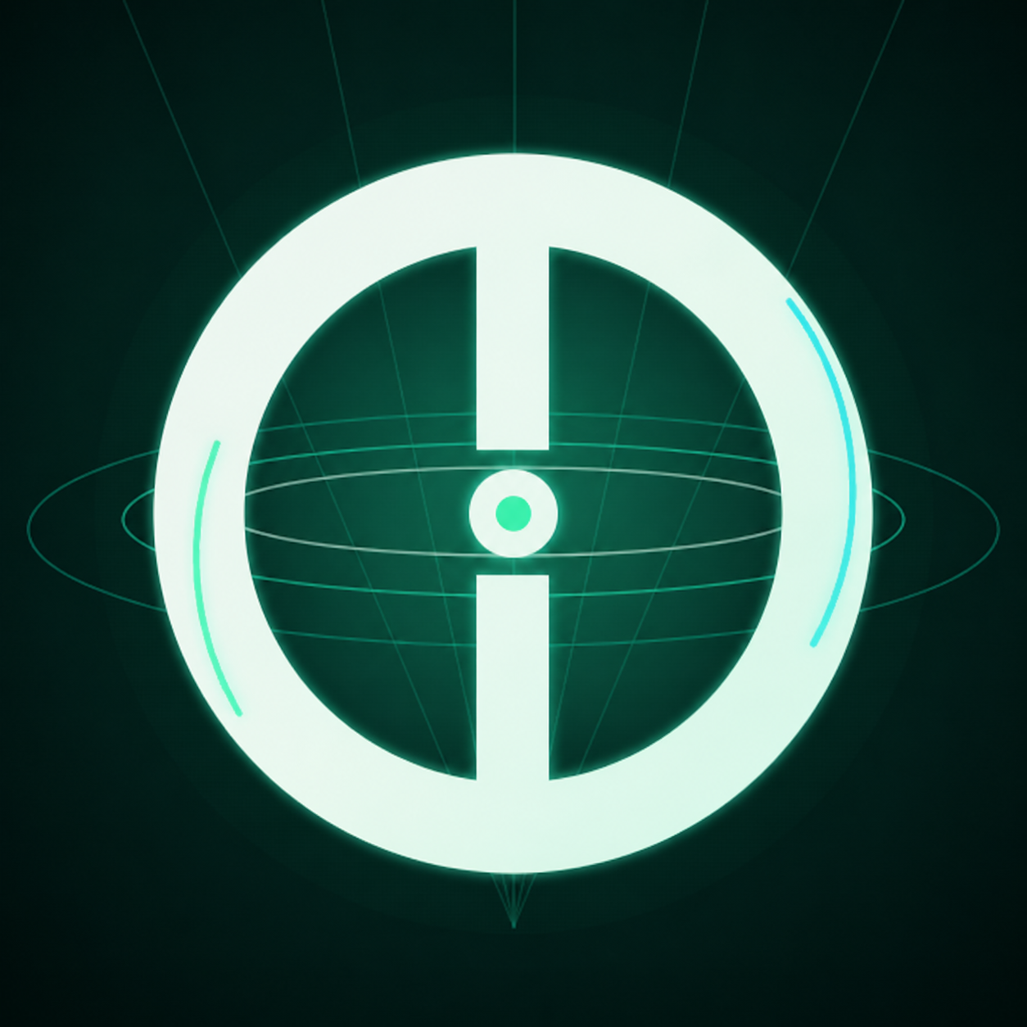
Product deck / revision 2026-09-11-1
SpaceOnne
ONNE
Digital space — an ecosystem asset
From Satoshi to TON
Web3 energy of the future is in your hands
SpaceOnne
01

Slide 2
Product thesis
Two digital-map models
Centralized model
Decentralized model
> $3B per year
Street View · Look Around · Streetside
High cost · slower refresh · limited capture network
The digital map is formed by every participant's contribution.
Fast · scalable · current · distributed participation
The estimate illustrates industry scale and is not a current audited spending figure for any individual company.
SpaceOnne
02

Slide 3
Product surface
One app — five connected surfaces
Home
Balance, quick actions, and navigation
Unified account
Atlas
Map, tasks, and contribution to digital space
Content · assets · market · communication
Wallet
ONNE, GRAM, USDT, and supported assets
The current interface determines feature scope and availability.
Buy / Sell
Available market and exchange tools
Chat
Messages, groups, and interaction
SpaceOnne
03

Slide 4
Atlas
Target production flow
Capture
Metadata
AI review
Community
review
Map
Reward
(if active)
This is the target flow: review, publication, and reward stages are enabled as the relevant production flow becomes ready.
SpaceOnne
04

Slide 5
Atlas status
Availability follows the current service mode
Available now
Staged enablement
Source of truth
Map, Atlas interface, available-task browsing, and training scenarios — depending on account, location, and version.
Capture, multi-stage review, publication, and real rewards may be enabled separately and at different times.
Each task screen shows the applicable requirements, status, geography, and whether a reward is available.
A 3D label may refer to route-based GPS/JPEG evidence capture and does not always mean a finished three-dimensional model.
SpaceOnne
05

Slide 6
Protocol 101
Staking today, Atlas validation in stages
Active layer
Target role
Conditional commission
Protocol 101 and available staking mechanics operate under the rules shown in the app.
Miner owners may participate in collective Atlas review once the relevant stage is enabled.
Commissions and other rewards arise only when the mechanism is active and expressly shown to the user.
Terms, timing, levels, and availability follow the current product rules and may change.
Staking and miner mechanics do not guarantee yield, value, or future results.
SpaceOnne
06

Slide 7
Wallet & community
Assets under user direction
Assets
Operations
User-directed actions
ONNE, GRAM — the native TON network asset, USDT, and other supported assets.
Deposits, withdrawals, transfers, available exchange tools, and staking.
The user selects the parameters and initiates and confirms each operation.
Community
Network settlement
Chats, groups, messages, and in-app interaction.
SpaceOnne does not hold assets off-chain; blockchain operations are recorded on the applicable asset network.
SpaceOnne
07

Slide 8
ONNE tokenomics
Supply and initial allocation
Total supply
Team allocation and early conversion are subject to vesting and liquidity gates.
1 010 000 000 ONNE
Atlas / staking / rewards / ecosystem
29.703%
Liquidity + market making
23.762%
Listings / partners / operations
15.842%
Treasury / reserve
12.871%
Team locked vesting
9.901%
Pre-DEX Point conversion
7.921%
SpaceOnne
08

Slide 9
Current token facts
Verifiable parameters without price promises
Total supply
Historical denomination
Market data
1 010 000 000 ONNE
215.551052515 Point = 1 ONNE
Price, liquidity, and availability come from the current interface, network, and selected route.
Official ONNE contract on TON
EQAhDhLYceb_BrItaTPK7U6Y4xLnEXsQO9iOILEz37CIcwFe
These materials do not promise price, liquidity, yield, or listing.
SpaceOnne
09

Slide 10
Roadmap
Three product epochs
01
02
03
Free distribution
ONNE + Protocol 101
Atlas / RWA
Completed
Token and staking active
Staged expansion
SpaceOnne is available as an installable web app and through supported interfaces, including Telegram. Proof of Work and production Atlas rewards are enabled only as they become ready.
SpaceOnne
10

Slide 11
Closing
Digital space — an ecosystem asset
SpaceOnne connects participant contribution, quality review, the mapping product, and ONNE. The broader, better, and more current the shared content, the stronger its role in the ecosystem economy.
Official ONNE token on TON
EQAhDhLYceb_BrItaTPK7U6Y4xLnEXsQO9iOILEz37CIcwFe
These materials describe current and target product mechanics, do not promise rewards or token value, and do not constitute financial, investment, tax, or legal advice.
SpaceOnne
11

